Slide 1

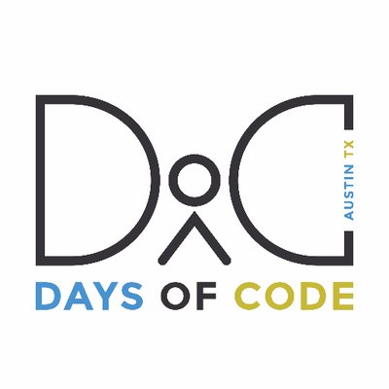
Data Science
by
Maha Siam

Slide 2

About Me :
MBA in International Business from Thailand
Freelance Thai Interpreter
GM & COE(Chief Of Everything) at MyHome.com
Basic Web Developer from ACC
Python: e-Learning at DataCamp

Slide 3
What did I learn?
Self-learning >= torturing!
Peers learning + Mentoring = AMAZING!!!
Good Data Scientist = Good Housekeeping

Slide 4
My Projects
Web Scraping
Web Scraping is a computer software technique of extracting information from websites. This technique mostly focuses on the transformation of unstructured data (HTML format) on the web into structured data (database or spreadsheet).
https://www.nytimes.com/interactive/2017/06/23/opinion/trumps-lies.html

Slide 5
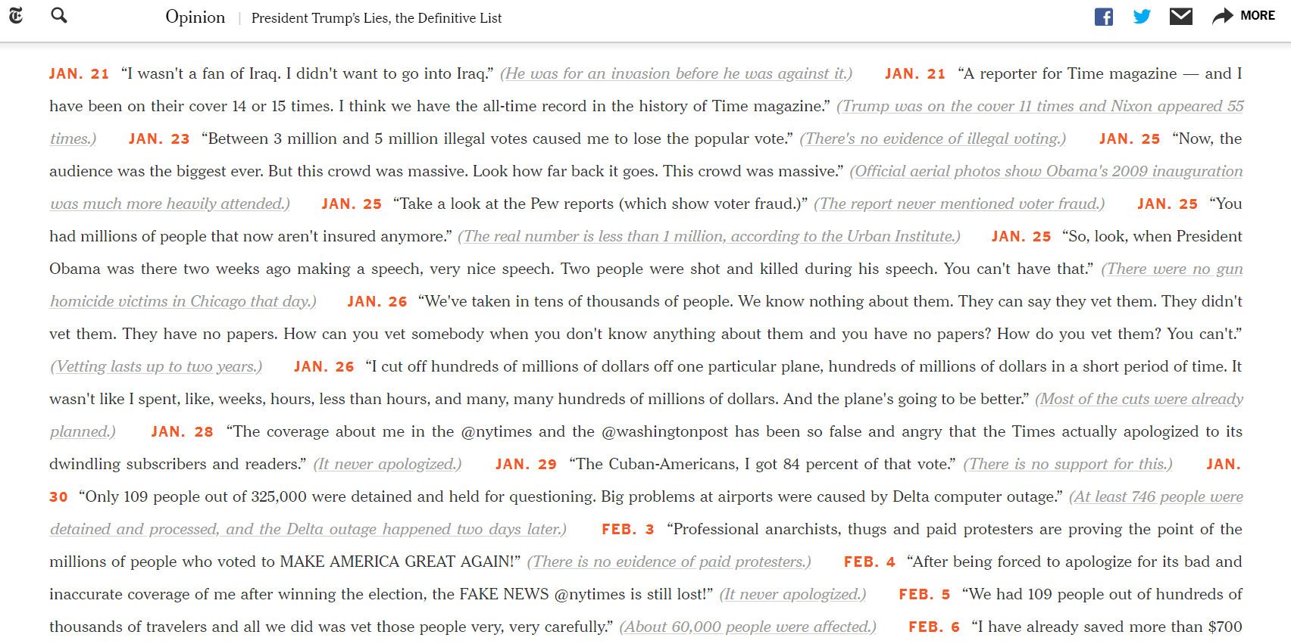
Web Scraping from New York Times Website

Slide 6
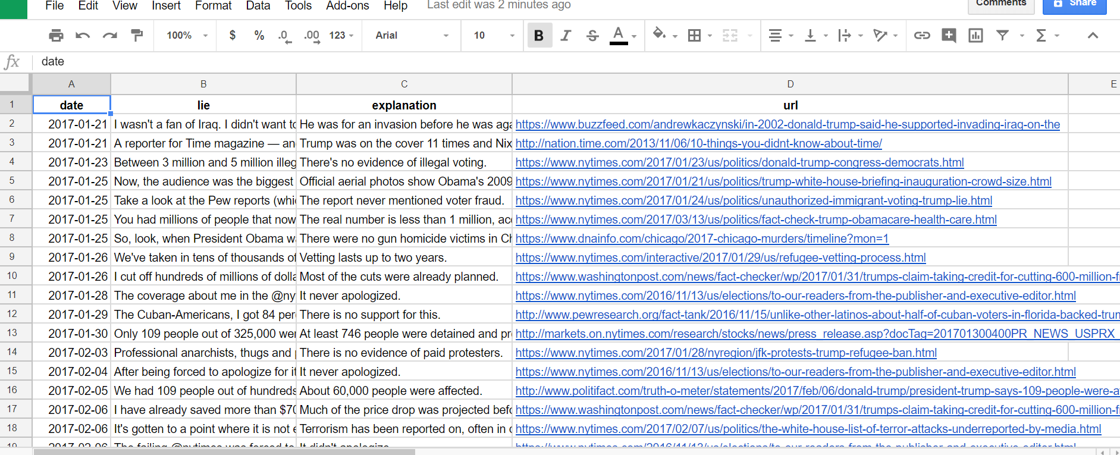
Transformed HTML text to data spreadsheet.

Slide 7
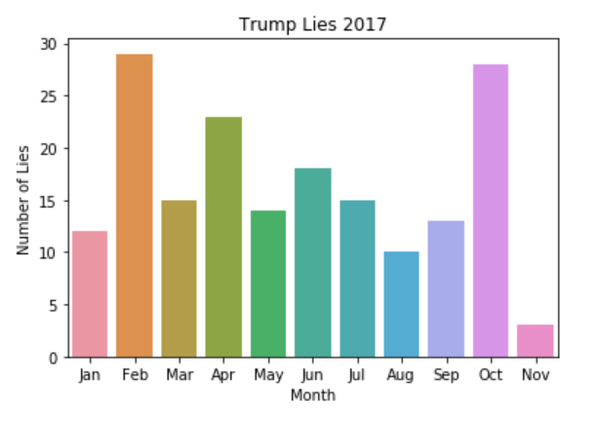
Python Data Visualization

Slide 8
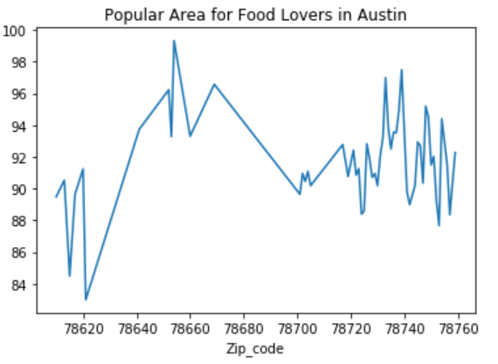
2. Restaurant Inspection Scores : Austin, TX
Can Food Inspection Data Standards Stop an Epidemic?
Import data from The Austin/Travis County
Health and Human Services Department
Explore and clean data
Manipulate the data to extract
lots of valuable information
Built visualization
https://bokeh.pydata.org/en/latest/

Slide 9
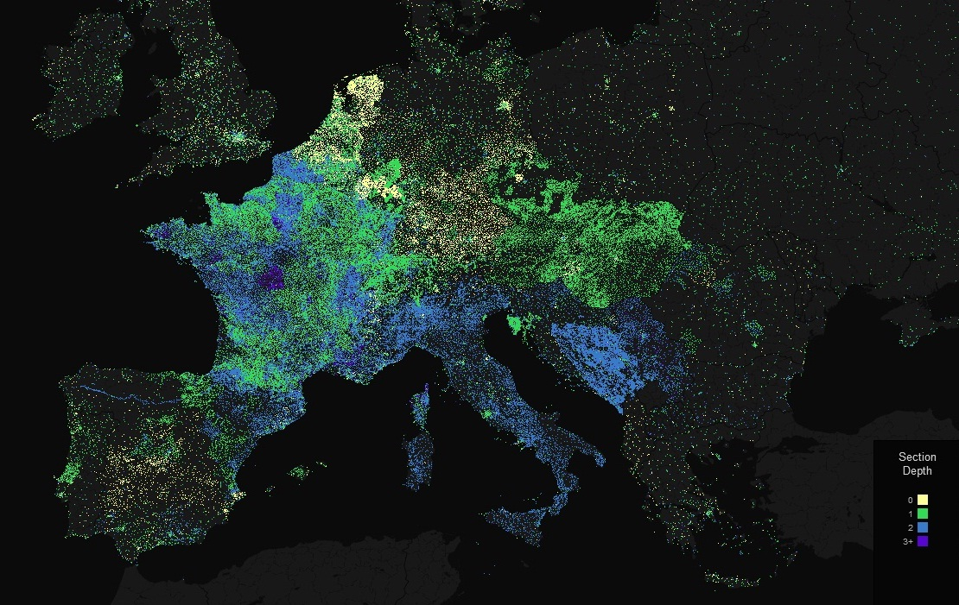
What do I want to do next?
Keep Learning !!!
‘Finish Restaurant Inspection Scores Project’
“Apply for 100 Days of Code in summer 2018”

Slide 10

Special Thanks to:
I am so grateful being part of the program.
Muriel & Days Of Code Program
My mentors Gregory and Meghann
My team and all of amazing peers!
Data School and DataCamp tutorials

